Slide 1
Computer Networks 21CSA212
Lecture: The reference model

Slide 2
Computer Network Models
Layered Architecture:
To reduce the design complexity, networks are organized as a stack of layers
Each lower layer adds its services to the higher layer to provide a full set of services to manage communications and run the applications.
It ensures the independence between layers by providing the services from lower to higher layer without defining how the services are implemented. Therefore, any modification in a layer will not affect the other layers.

Slide 3
The number of layers, functions, contents of each layer will vary from network to network.
The basic elements of layered architecture are services, protocols, and interfaces.
Service: It is a set of actions that a layer provides to the higher layer.
Protocol: It defines a set of rules that a layer uses to exchange the information with peer entity. These rules mainly concern about both the contents and order of the messages used.
Interface: It is a way through which the message is transferred from one layer to another layer.

Slide 4
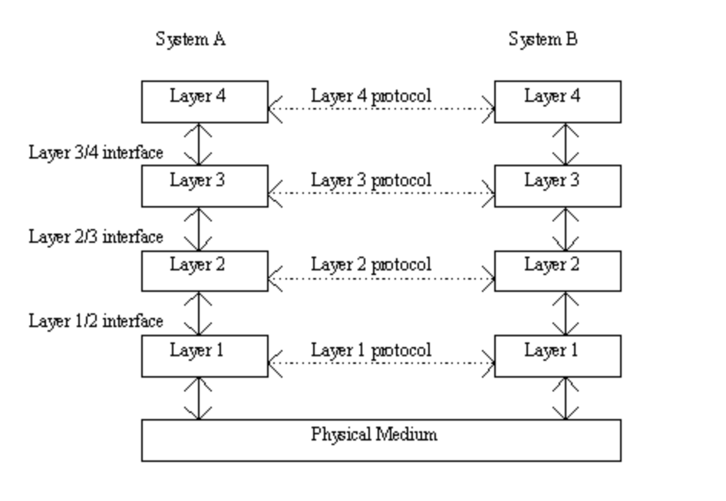
Layered Architecture

Slide 5
Need for layered architecture
Divide and Conquer Approach: The unmanageable and complex task is further divided into smaller sub tasks. Each sub task is then carried out by the different layer. Therefore using this approach reduces the complexity of the problem or design process.
Easy to Modify: The layers are independent of each other in layered architecture. If any sudden change occurs in the implementation of one layer, it can be changed. This change does not affect the working of other layers involved in the task.

Slide 6
Need for layered architecture
Modularity: Layered architecture is more modular as compared to other architecture models in computer network. Modularity provides with more independence between the layers and are more easier to understand.
Easy to Test: Each layer in layered architecture performs a different and dedicated task. Therefore each layer can be analyzed and tested individually. It helps to analyze the problem and solve them more efficiently as compared to solving all the problems at a time.

Slide 7
The OSI model
OSI stands for Open Systems Interconnection
This model is based on a proposal developed by International Standards Organization(ISO)
This model is also known as ISO OSI Reference Model
It deals with connecting open systems( systems that are open for communication with other systems)
OSI is a seven layered architecture

Slide 8
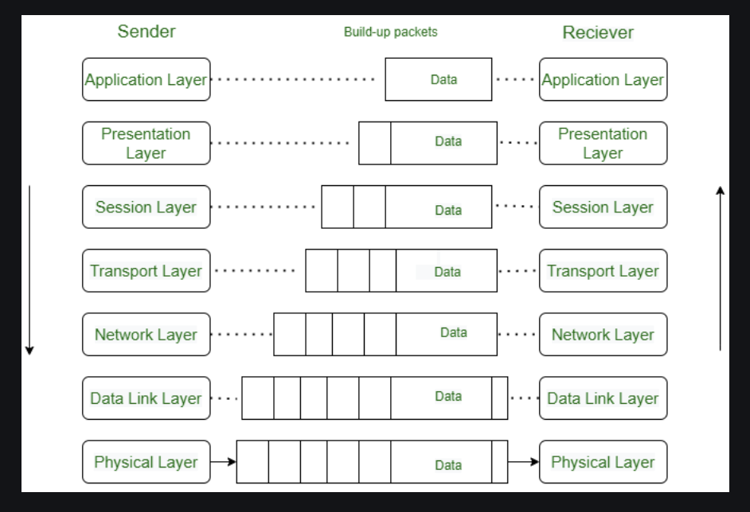
The OSI Model

Slide 9
Layers of OSI model
The Physical Layer:
Physical layer is the lowest layer of OSI model and is responsible for the physical connection between all the required devices.
The information present in physical layer is in the form of bits. Hence, this layer is concerned with transmitting raw bits over communication channel
Physical layer performs various functions such as bit rate control, bit synchronization, transmission mode etc.
Make sure that when one side sends a 1 bit it is received by the other side as a 1 bit, not as a 0 bit.

Slide 10
The Data Link Layer:
The data link layer is responsible for the node-to-node delivery of the message.
The main function of this layer is to make sure data transfer is error-free from one node to another, over the physical layer.
When a packet arrives in a network, it is the responsibility of the DLL to transmit it to the Host using its MAC address.

Slide 11
The Network Layer:
The network layer works for the transmission of data from one host to the other located in different networks.
It also takes care of packet routing i.e. selection of the shortest path to transmit the packet, from the number of routes available. The sender & receiver’s IP addresses are placed in the header by the network layer.

Slide 12
The Transport Layer:
The transport layer provides services to the application layer and takes services from the network layer.
The data in the transport layer is referred to as Segments.
It is responsible for the End to End Delivery of the complete message.
The transport layer also provides the acknowledgment of the successful data transmission and re-transmits the data if an error is found.

Slide 13
At the sender’s side:
The transport layer receives the formatted data from the upper layers, performs Segmentation, and also implements Flow & Error control to ensure proper data transmission. It also adds Source and Destination port numbers in its header and forwards the segmented data to the Network Layer.

Slide 14
The Session Layer
This layer is responsible for the establishment of connection, maintenance of sessions, and authentication, and also ensures security.

Slide 15
The Presentation Layer
The presentation layer is also called the Translation layer. The data from the application layer is extracted here and manipulated as per the required format to transmit over the network.

Slide 16
The Application Layer:
At the very top of the OSI Reference Model stack of layers, we find the Application layer which is implemented by the network applications.
These applications produce the data, which has to be transferred over the network.
This layer also serves as a window for the application services to access the network and for displaying the received information to the user.

Slide 17
The TCP/IP Reference Model/Internet Protocol Suite
TCP/IP was designed and developed by the Department of Defense (DoD) in the 1960s
It stands for Transmission Control Protocol/Internet Protocol.
It contains Five/four layers
To ensure that, each message reaches its final destination accurately, the TCP/IP model divides its data into packets and combines them at the other end, which helps in maintaining the accuracy of the data while transferring from one end to another end.

Slide 18
TCP/IP
The most popular network protocol in the world, TCP/IP protocol suite, was designed in 1970s by 2 DARPA scientists—Vint Cerf(Vinton Gray "Vint" Cerf) and Bob Kahn(Robert Elliot Kahn ), persons most often called the fathers of the Internet.

Slide 19
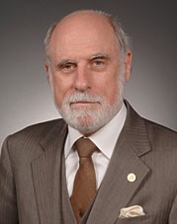
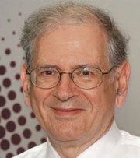
Vinton Gray "Vint" Cerf Robert Elliot Kahn

Slide 20
Why TCP/IP Model
TCP/IP that is Transmission Control Protocol and Internet Protocol was developed by Department of Defense Advanced Research Projects Agency(ARPA, later DARPA) as a part of a research project of network interconnection to connect remote machines.
The features that stood out during the research, which led to making the TCP/IP reference model were:

Slide 21
Support for a flexible architecture. Adding more machines to a network was easy.
The network was robust, and connections remained intact until the source and destination machines were functioning.

Slide 22
Working of TCP/IP model
Whenever we want to send something over the internet using the TCP/IP Model, the TCP/IP Model divides the data into packets at the sender’s end and the same packets have to be recombined at the receiver’s end to form the same data.
TCP/IP model divides the data into a 4-layer procedure, where the data first go into this layer in one order and again in reverse order to get organized in the same way at the receiver’s end.

Slide 23
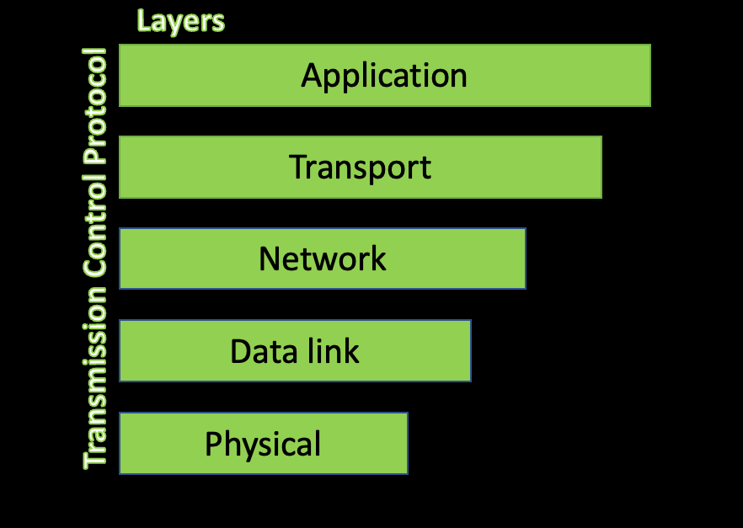
The TCP/IP Reference Model

Slide 24
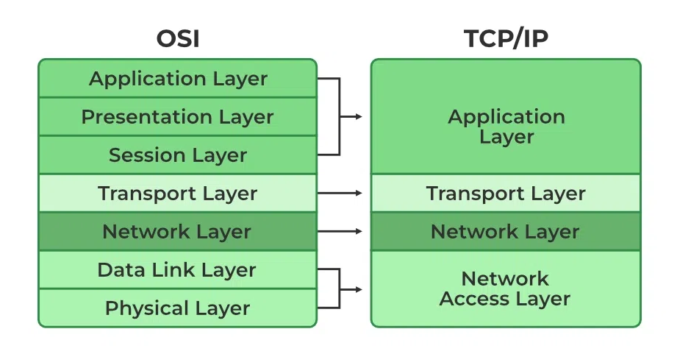

Slide 25
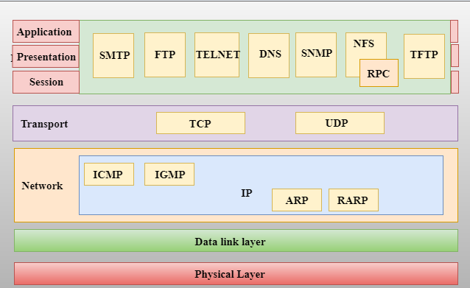

Slide 26
Application layer
An application layer is the topmost layer in the TCP/IP model.
It is responsible for handling high-level protocols, issues of representation.
This layer allows the user to interact with the application.
﻿﻿This is the place where high level protocols reside and those protocols include FTP, SMTP, DNS, SNMP and HTTP.
﻿﻿File Transfer Protocol(FTP) : To permit reliable transfer of files between different platforms. It uses TCP at the transport layer.
﻿﻿Hyper Text Transfer Protocol(HTTP): Permits applications such as browsers to upload and download web pages. To check reliability, it makes use of TCP at the transport layer. HTTP delivers HTML documents
﻿﻿Simple Mail Transfer Protocol (SMTP) : Helps to send email to other computers that support TCP/IP protocol suite.

Slide 27
Application layer
﻿﻿Domain Name System(DNS) Protocol: Allows the network determine the IP address from name and vice versa
﻿﻿Simple Network Management Protocol (SNMP) : For the transport of network management information
﻿﻿Telnet Protocol: This is the virtual terminal protocol which allows the user in one machine to log into another machine and work

Slide 28
Transport Layer
﻿﻿The transport layer is responsible for the transport of data
The transport layer is responsible for the reliability, flow control, and correction of data which is being sent over the network.
The protocols used in this layer is TCP and UDP
﻿﻿Transport layer communicates data between two applications running on computers, making use of port numbers
﻿﻿It also incorporates error detection
﻿﻿TCP(Transmission Control Protocol): It is a reliable connection oriented protocol that permits a byte stream originating on machine to be transported without error to any machine in the internet.
﻿﻿UDP(User Datagram Protocol) : It is an unreliable connectionless protocol for applications that do not want TCP's sequencing on flow control.

Slide 29
Internet Layer
﻿﻿This layer is responsible for sending packets through different networks
An internet layer is the second layer of the TCP/IP model.
An internet layer is also known as the network layer.
The main responsibility of the internet layer is to send the packets from any network, and they arrive at the destination irrespective of the route they take.
﻿﻿The internet layer encapsulates the segments from the Transport Layer into envelopes called packets and then determines the path the information is to take across the network
﻿﻿IP(Internet Protocol): Responsible for delivering packets from source to destination by looking at the IP addresses
﻿﻿ARP(address Resolution Protocol): Used to find Ethernet(hardware) address from a specific IP address

Slide 30
﻿﻿ICMP(Internet Control Message Protocol) : Provides management and error reporting to help manage the process of sending data between computers
﻿﻿IGMP(Internet Group Message Protocol): Supports multicasting
﻿﻿RARP(Reverse Address Resolution Protocol) : Allows a computer without a logical permanent data storage media to determine its IP address from its Ethernet address

Slide 31
Link Layer or Network Access Layer
﻿A network layer is the combination of the Physical layer and Data Link layer defined in the OSI reference model.
It defines how the data should be sent physically through the network.
This layer is mainly responsible for the transmission of the data between two devices on the same network.
﻿The link layer offers the ability to access the physical network to transmit data
﻿﻿Breaks down the packets from the Internet layer into frames and then eventually into bits for transmission across the physical network medium
﻿﻿Contains all specifications relating to the transmission of data over a physical network
﻿﻿Routing and synchronizing data over a network, checking data formats, converting signals and error detection in the transmitted data

Slide 32
Signaling and network medium standards such as Ethernet, Token ring, FDDI, X.25, Frame Relay, Point-to-Point Protocol (PPP), RS 232 etc. are defined in this layer
﻿﻿Network Interface Cards, hubs, repeaters, switches etc. operate at this layer

Slide 33
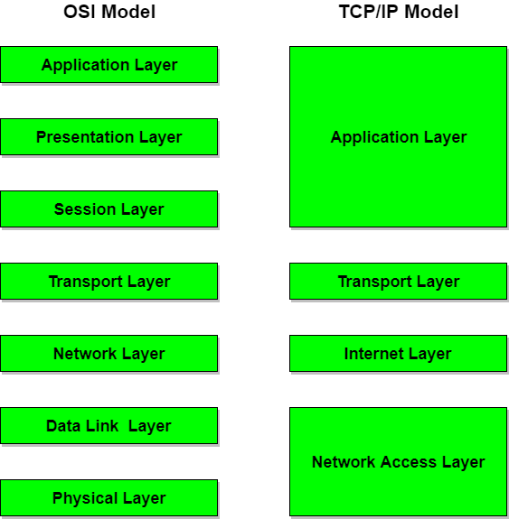
Diagrammatic Comparison between OSI Reference Model and TCP/IP Reference Model

Slide 34
Following are some similarities between OSI Reference Model and TCP/IP Reference Model.
Both have layered architecture.
Layers provide similar functionalities.
Both are protocol stack.
Both are reference models.

Slide 35
Difference between OSI and TCP/IP Reference Model

Slide 36
OSI(Open System Interconnection) | TCP/IP(Transmission Control Protocol / Internet Protocol)
1. OSI is a generic, protocol independent standard, acting as a communication gateway between the network and end user. | 1. TCP/IP model is based on standard protocols around which the Internet has developed. It is a communication protocol, which allows connection of hosts over a network.
2. In OSI model the transport layer guarantees the delivery of packets. | 2. In TCP/IP model the transport layer does not guarantees delivery of packets. Still the TCP/IP model is more reliable.
3. Follows vertical approach. | 3. Follows horizontal approach.
4. OSI model has a separate Presentation layer and Session layer. | 4. TCP/IP does not have a separate Presentation layer or Session layer.
5. Transport Layer is Connection Oriented. | 5. Transport Layer is both Connection Oriented and Connection less.

Slide 37
6. Network Layer is both Connection Oriented and Connection less. | 6. Network Layer is Connection less.
7. OSI is a reference model around which the networks are built. Generally it is used as a guidance tool. | 7. TCP/IP model is, in a way implementation of the OSI model.
8. Network layer of OSI model provides both connection oriented and connectionless service. | 8. The Network layer in TCP/IP model provides connectionless service.
9. OSI model has a problem of fitting the protocols into the model. | 9. TCP/IP model does not fit any protocol
10. Protocols are hidden in OSI model and are easily replaced as the technology changes. | 10. In TCP/IP replacing protocol is not easy.
11. OSI model defines services, interfaces and protocols very clearly and makes clear distinction between them. It is protocol independent. | 11. In TCP/IP, services, interfaces and protocols are not clearly separated. It is also protocol dependent.
12. It has 7 layers | 12. It has 4 layers

